Slide 1


Intelligent system
Emotional Recognition
Daussaint Romain
Honnay Lucas
Industrial Engineer – Master 1
Academic Year 2020-2021

Slide 2





Intelligent system
Introduction : Why emotion recognition?
Security
Transport
Education
Marketing
Medecine
Introduction – Database – Training model – Results – Simulation– Conclusion

Slide 3
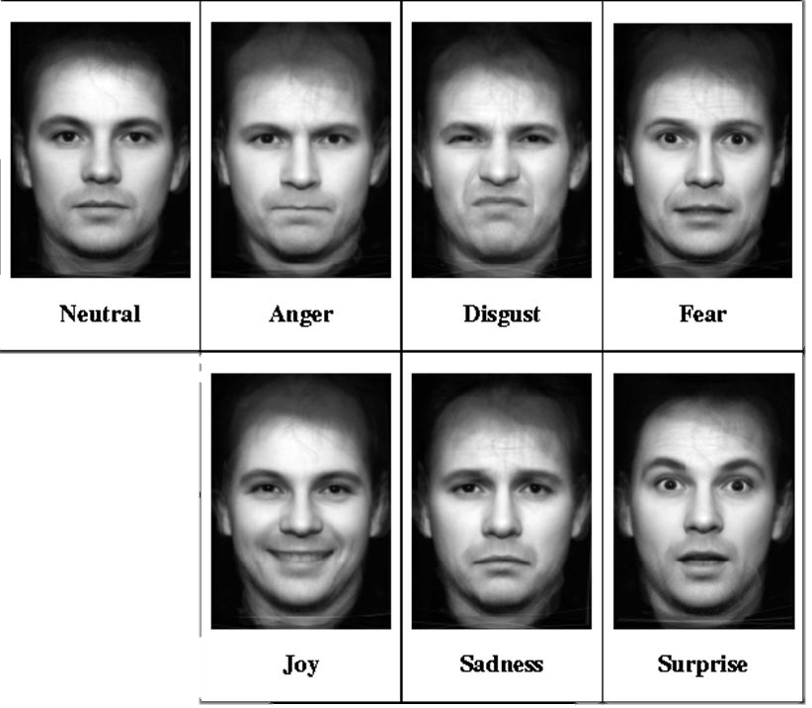
Intelligent system
Database → FER 2013 from Kaggle
Concist of :
28 709 examples of training
3 589 examples of test
7 classes of emotions
48x48 pixel grayscale pictures
Introduction – Database – Training model – Results – Simulation– Conclusion

Slide 4
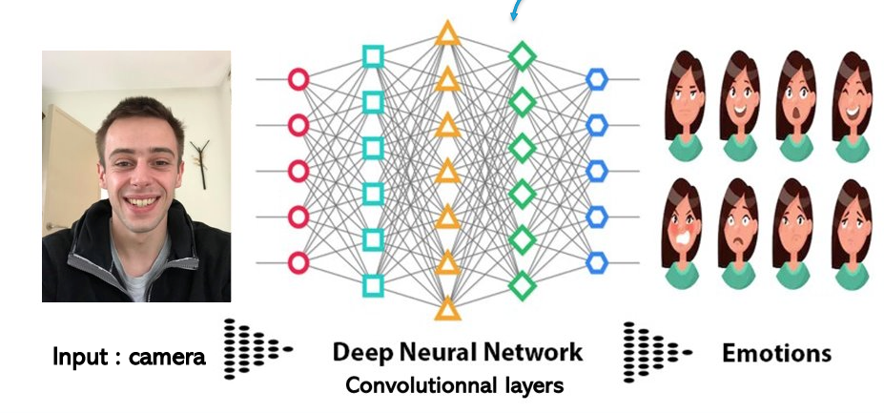
Intelligent system
Training model
Use of CNN
Introduction – Database – Training model – Results – Simulation– Conclusion

Slide 5
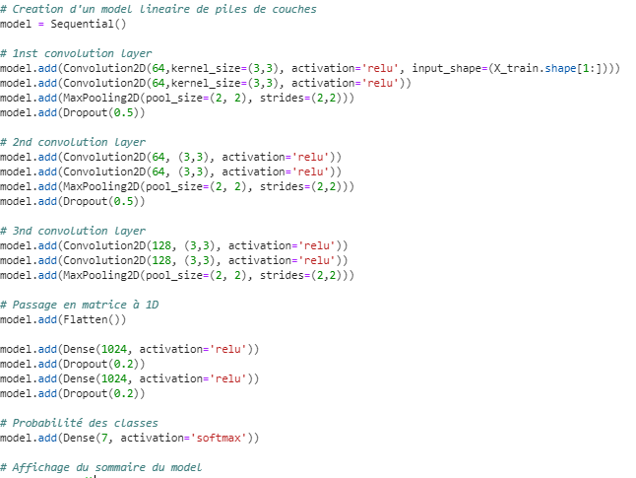
Intelligent system
Training model
Code :
3 convolutions layers
Matrix 1D
Probability of classes
Introduction – Database – Training model – Results – Simulation– Conclusion

Slide 6
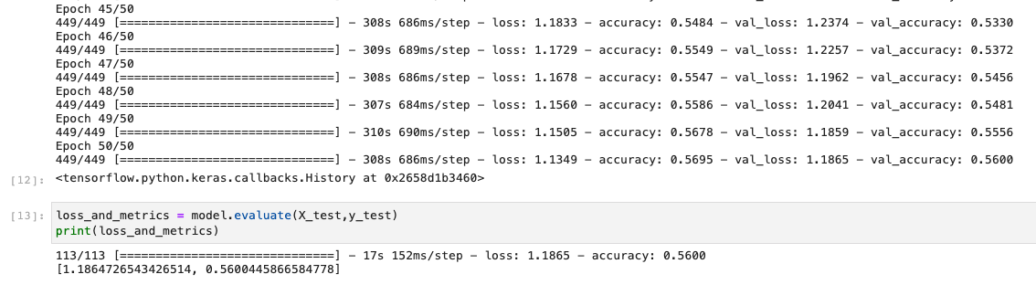
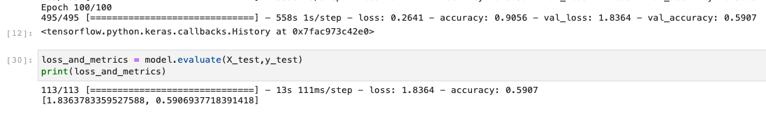
Intelligent system
Model results
Test accuracy : 56%
Training accuracy : 57%
50 Epochs
Overfitting :
Test accuracy : 0.59
Training accuracy : 0.90
Introduction – Database – Training model – Results – Simulation– Conclusion

Slide 7
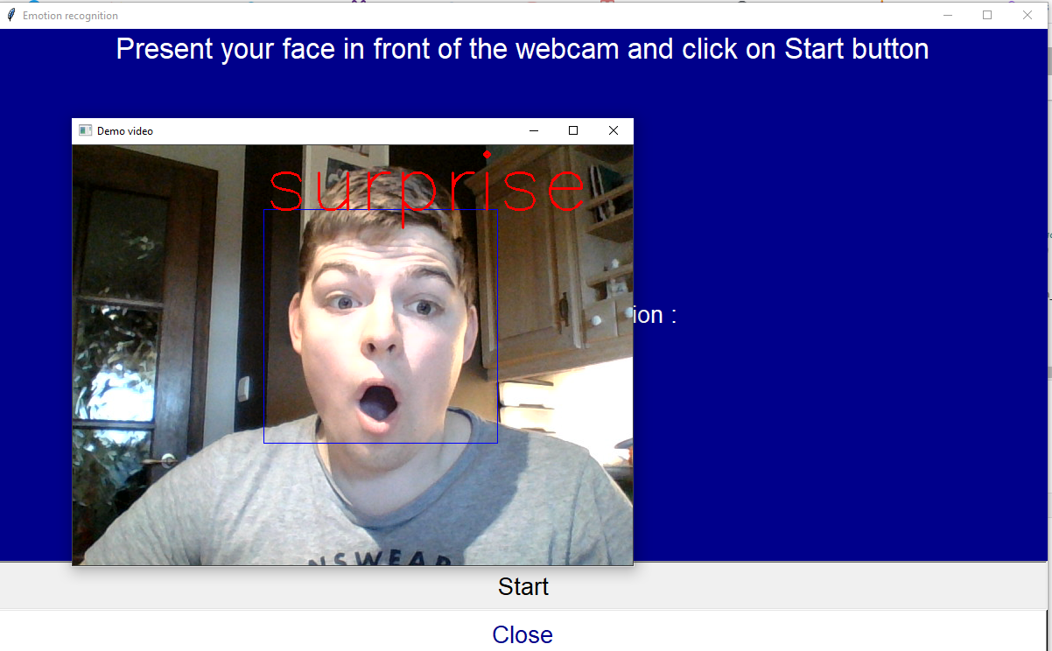
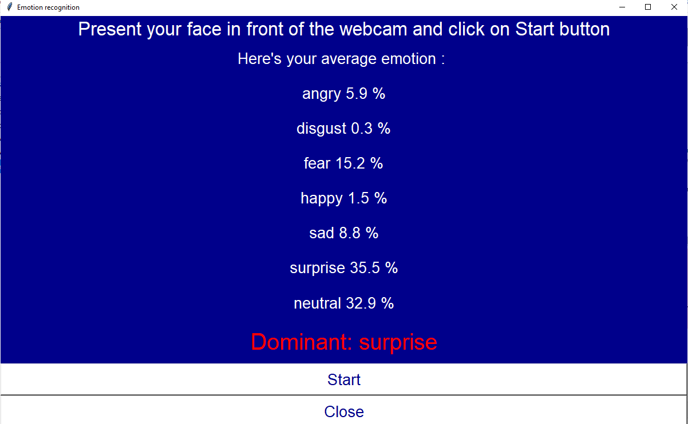
Intelligent system
Simulation
Introduction – Database – Training model – Results – Simulation– Conclusion

Slide 8

Intelligent system
Vidéo
Introduction – Database – Training model – Results – Simulation– Conclusion

Slide 9

Intelligent system
Conclusion
Refine the training model
Test with other database
Disgust is not well recognised
Add a body language reading to our model
Improve the accuracy
Introduction – Database – Training model – Results – Simulation – Conclusion

Slide 10

Intelligent system
Any questions ?

